Slide 1
RESTAURANT-APP

Slide 2
This is restaurant single page application.
This made using html css , typescript ,bootstrap,and angular cli.
Used postman for testing.
Used json server.

Slide 3
Why Angular?
Effective Cross-Platform Development.
High Quality of the Application.
Improved Speed and Performance.
Faster Development Process.
Readable and Testable Code.
More Lightweight Web Applications.
Efficient Problem-Solving Patterns.
Excellent Material Design Library.

Slide 4
Functionality out of the box
The default setup of Angular gives you everything you need, right out of the box. This includes tools to take care of routing, so you can easily fetch the data you want to present in your application. Angular’s preconfigured environment not only helps with development, but also facilitates testing.

Slide 5
TypeScript
Angular is built with TypeScript. The main advantage of this strongly typed language is that it helps developers to keep their code clean and understandable. Bugs are easier to spot and eliminate with the ability to see common errors as you type. This makes it quicker when it comes to debugging and also easier to maintain a large codebase – something which is particularly beneficial in large enterprise-scale projects.

Slide 6
Consistency
Angular is a fully-fledged responsive web design framework. A key feature is that there is one suggested way to create a component, service, or module.

Slide 7
ACTUAL PROJECT

Slide 8
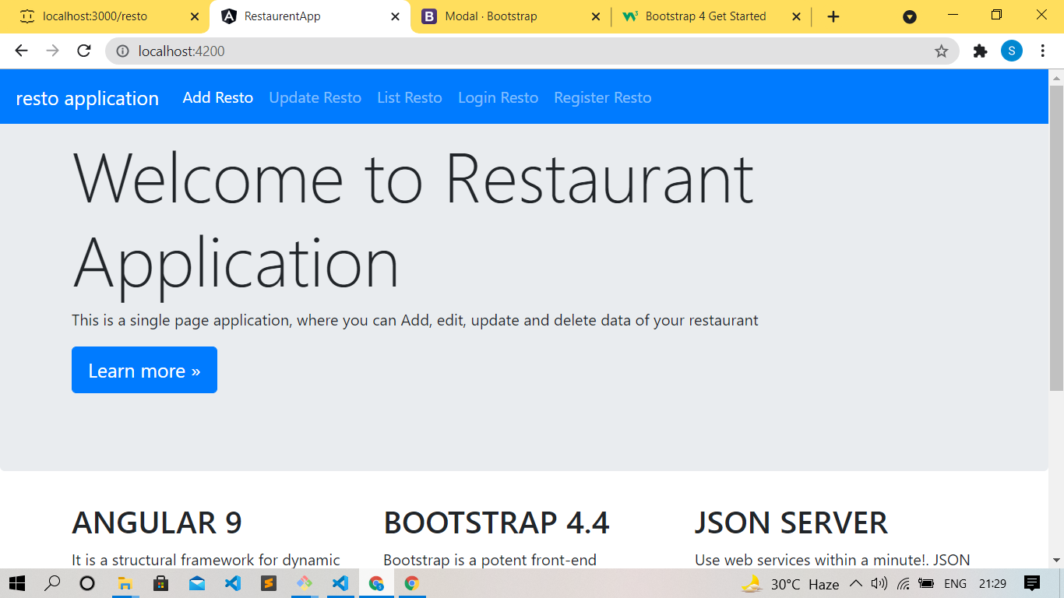

Slide 9
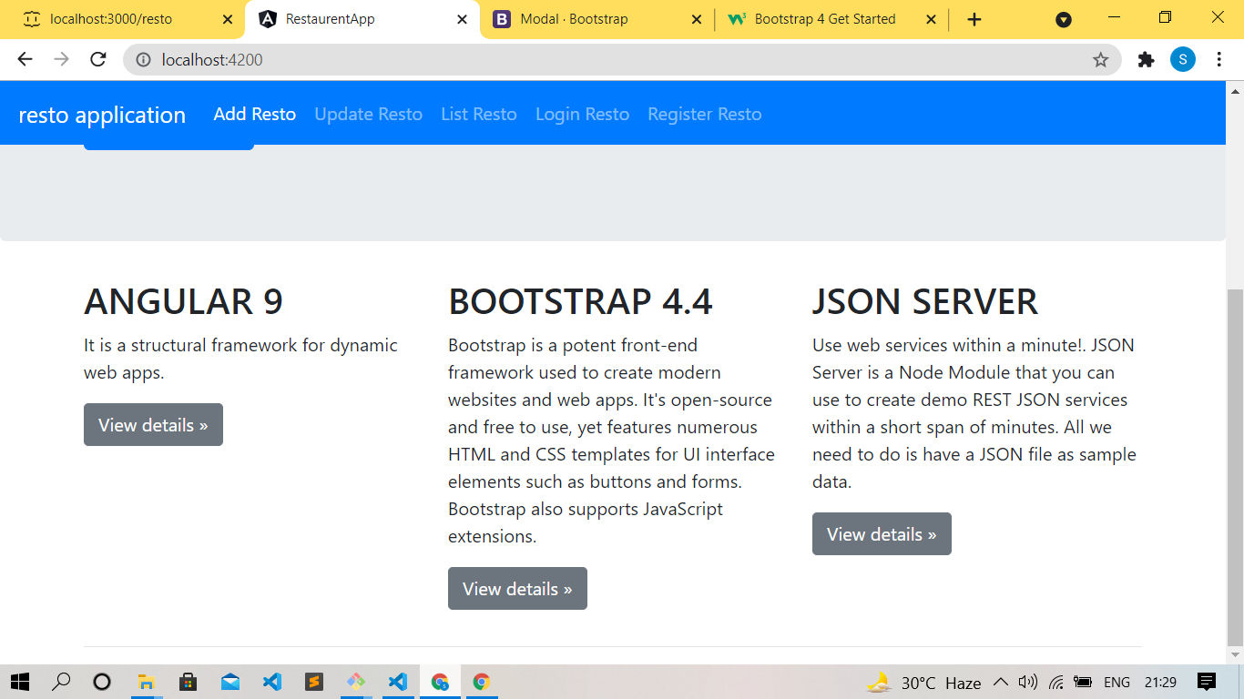

Slide 10
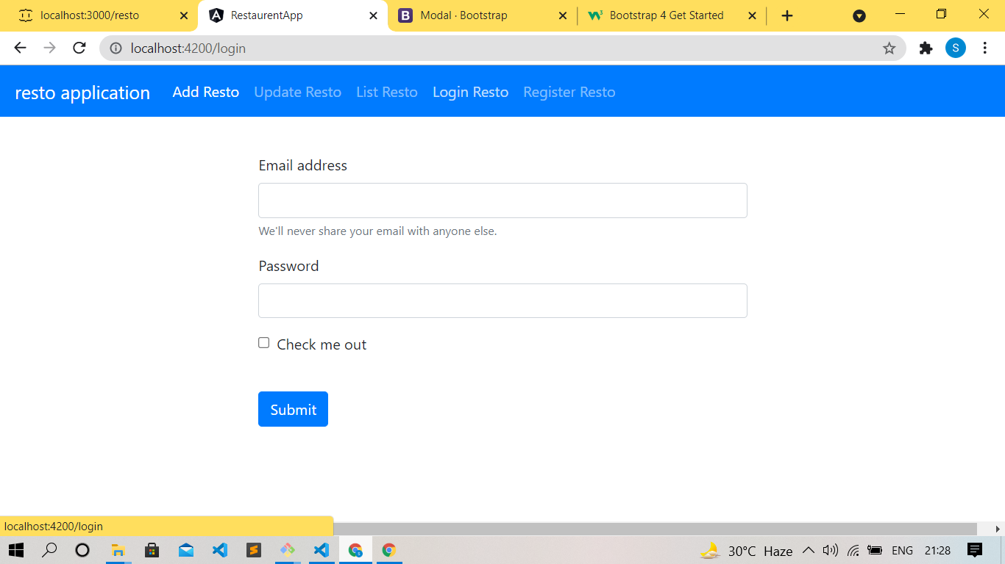

Slide 11
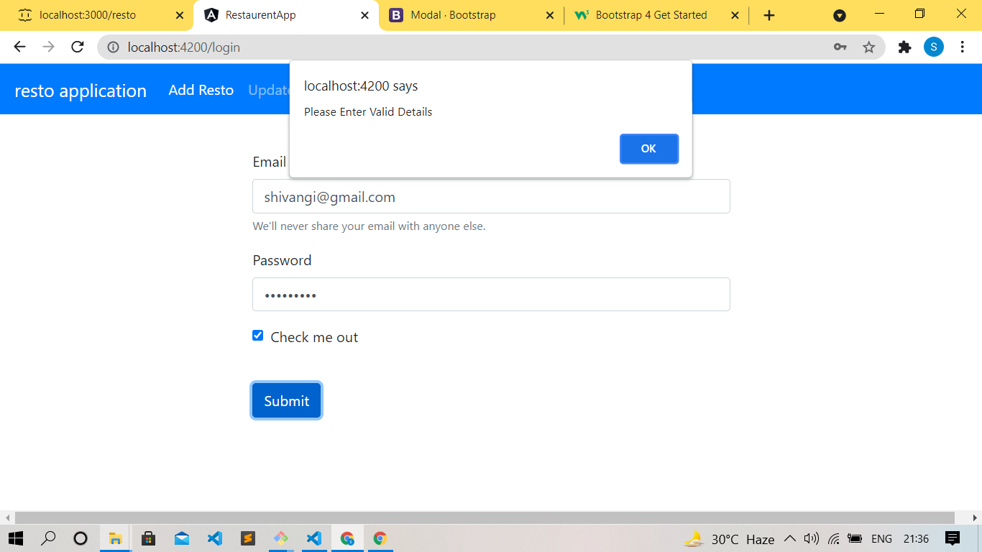

Slide 12
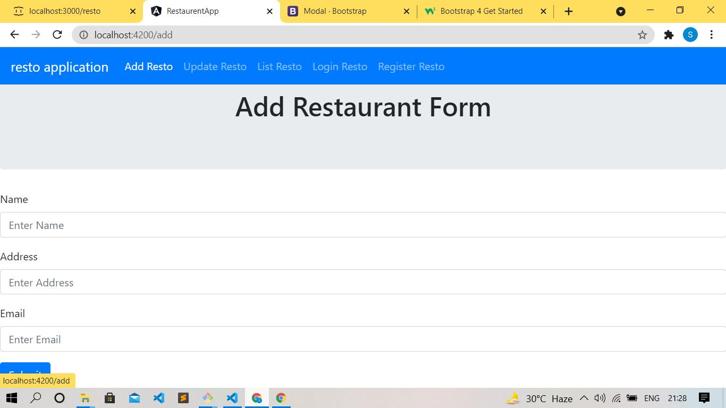

Slide 13
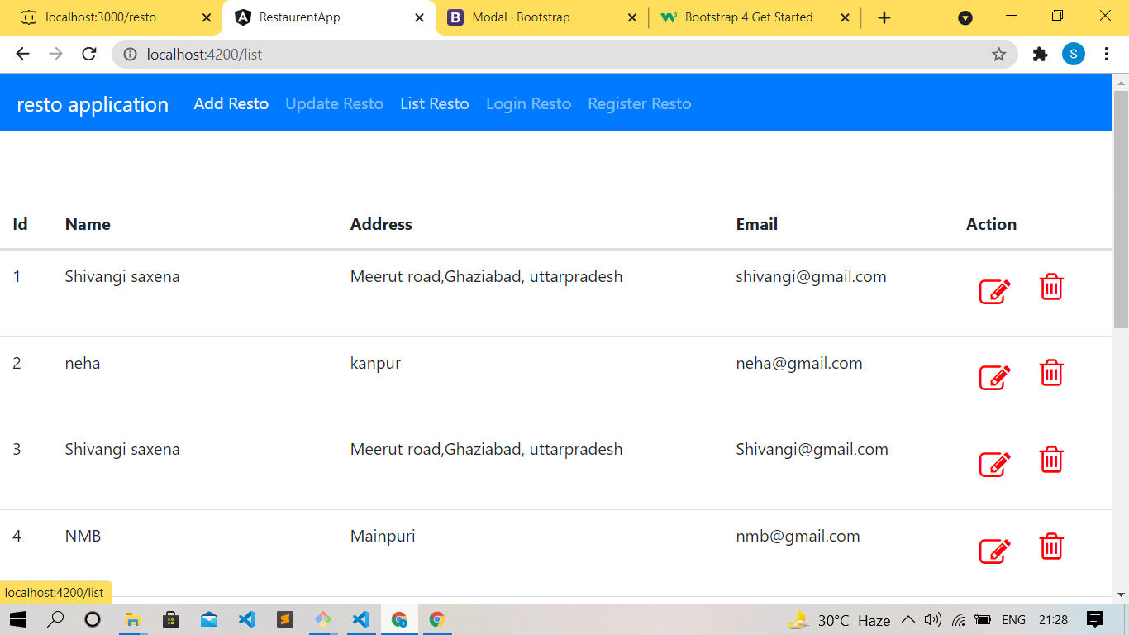

Slide 14
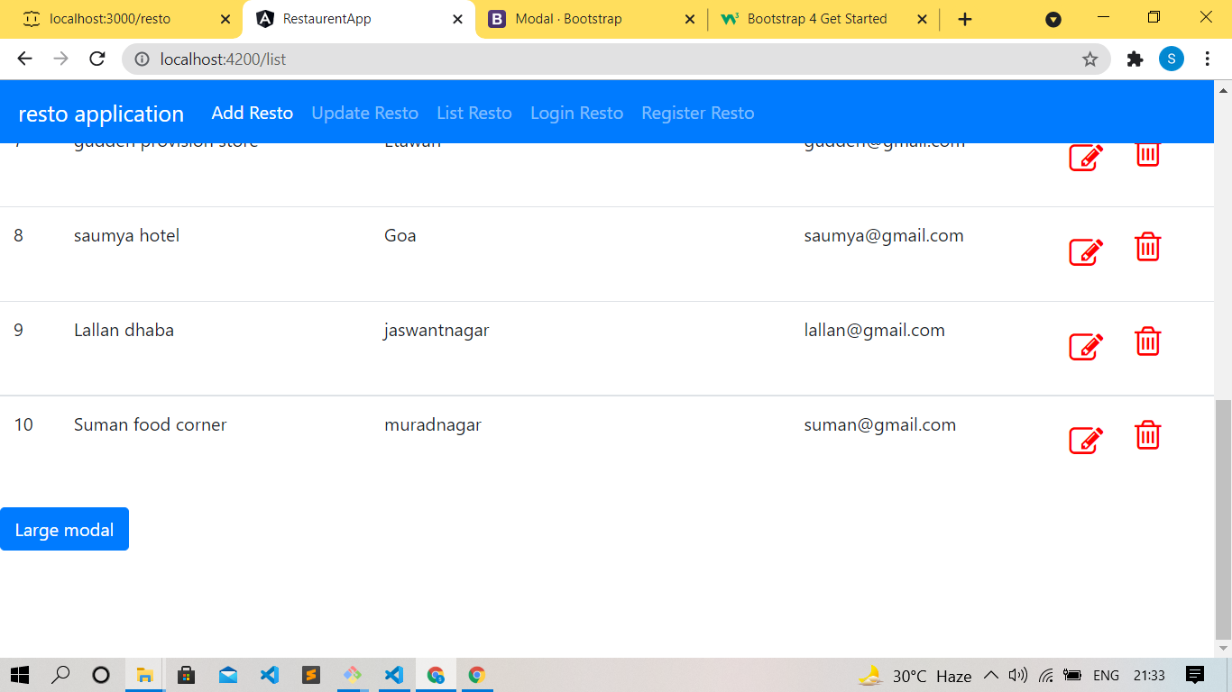

Slide 15
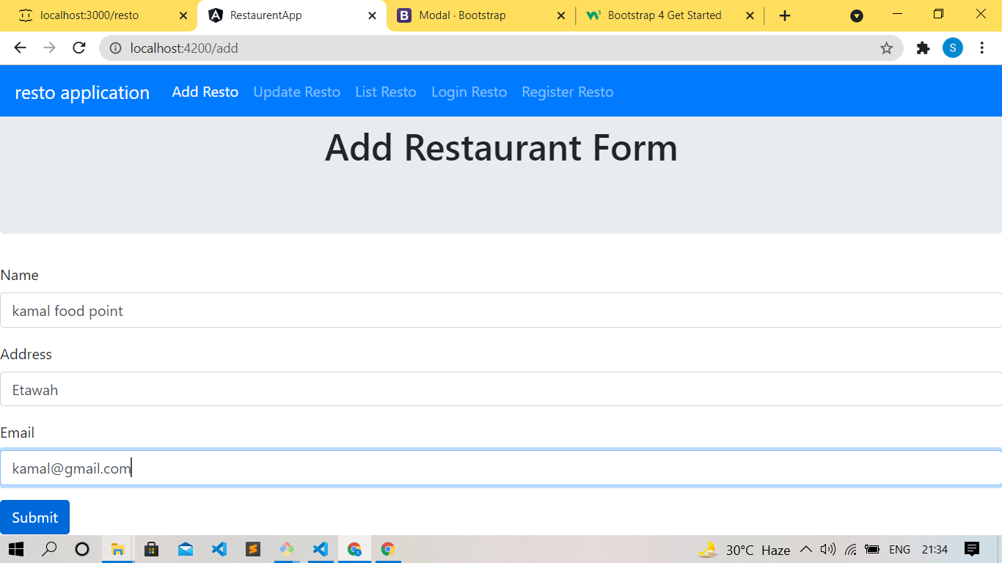

Slide 16
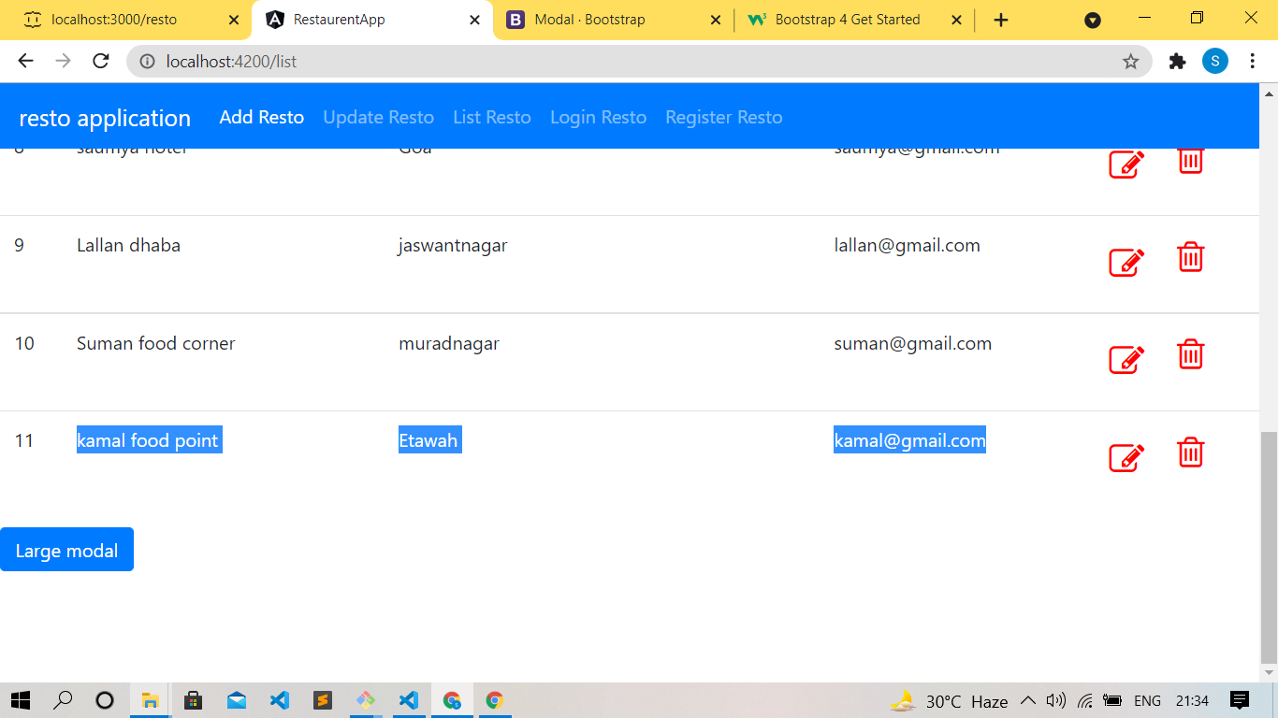

Slide 17
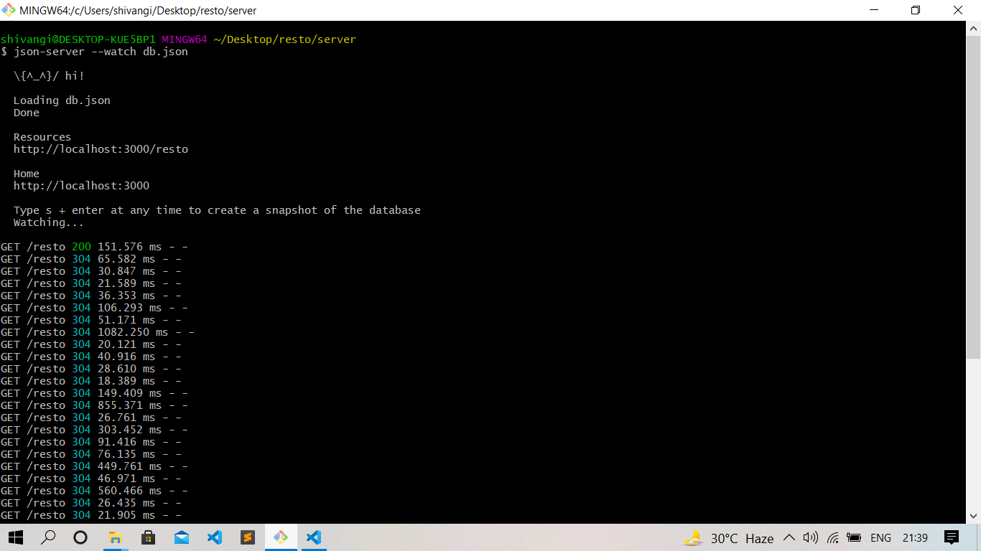

Slide 18
Github Link
https://github.com/0009shivangi/resto-app.git

Slide 19
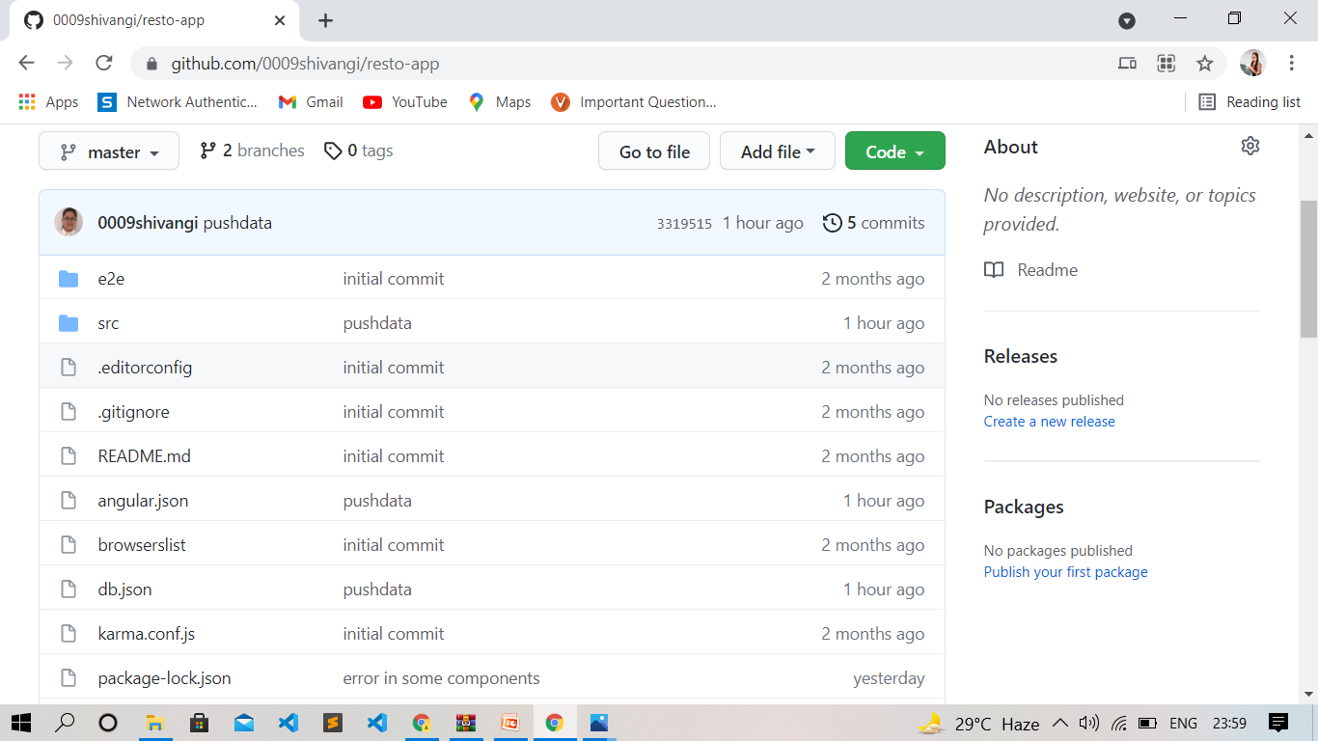

Slide 20
THANK YOU SOO MUCH!!

